Slide 1
Project: Netflix data
Tetsuichi

Slide 2
Contents
My role: a data visualization developer
List of visualizations
A visualization of the distribution of the stock prices for Netflix in 2017
A visualization and a summary of Netflix stock and revenue for the past four quarters and a summary
A visualization and a brief summary of their earned versus actual earnings per share
A visualization of Netflix stock against the Dow Jones stock (to get a sense of the market) in 2017

Slide 3
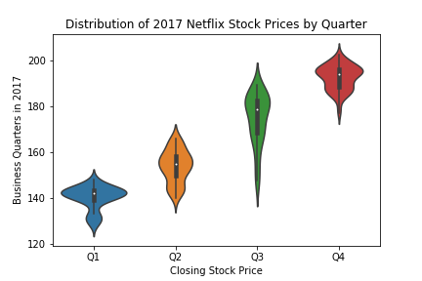

Slide 4
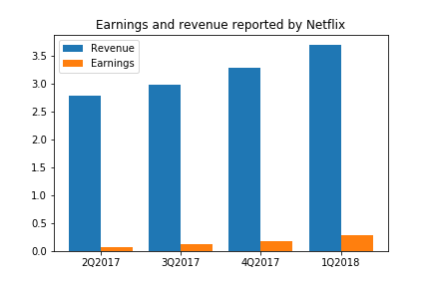

Slide 5
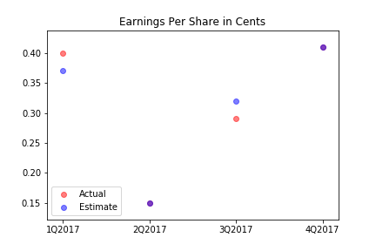

Slide 6
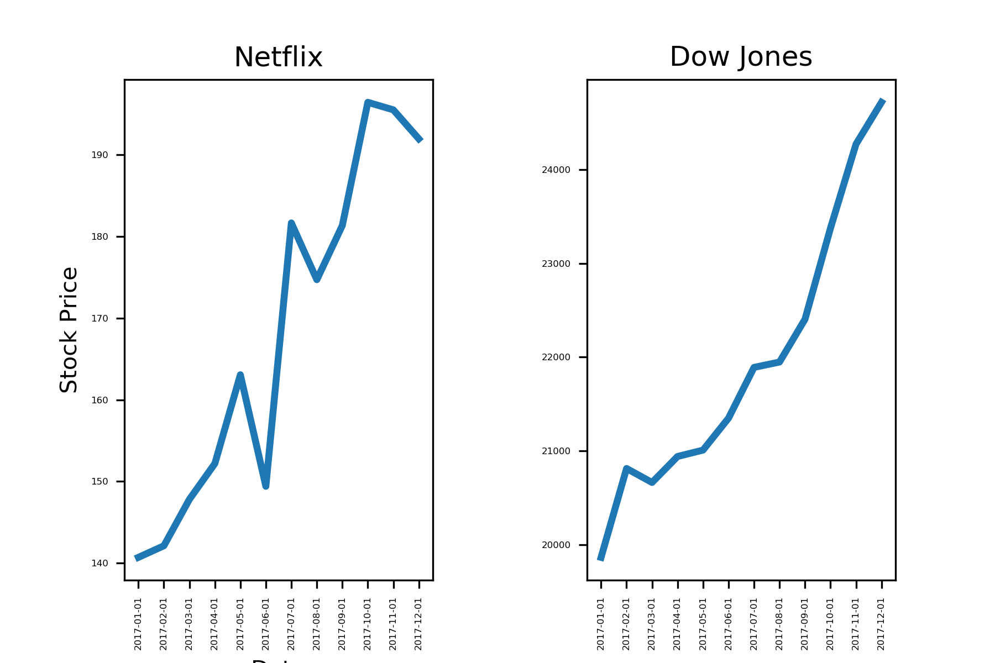
Comparison of stock price change

